Slide 1
React’s Separation of Concerns
Separation of Concerns.
React’s way?
https://reactjs.org/docs/introducing-jsx.html#why-jsx

Slide 2
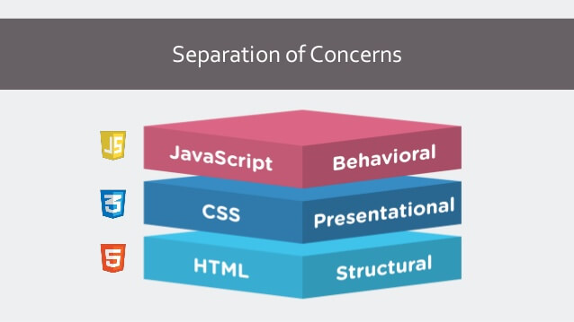
Separation of Concerns
This Photo by Unknown Author is licensed under CC BY-NC-SA

Slide 3

React’s Way

Slide 4
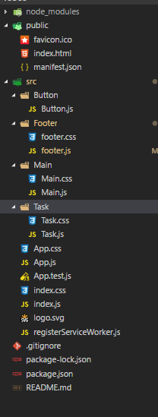
Separate components out into distinct folders.
Every component has HTML, CSS, and JavaScript all in 1.
Every component has it’s own concern, or responsibility to fulfill.

Slide 5
Uncontrolled and Controlled components.
Uncontrolled
Controlled
Stores state locally.
Has methods that can alter the DOM.
Passes data to other components as props.
Uses the virtual DOM.
Outputs values through props.
Notifies changes through callbacks to the parent component.
Uses the DOM.
Binds to DOM elements using the Ref keyword.

Slide 6
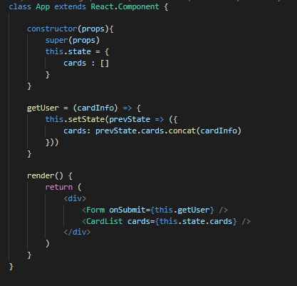
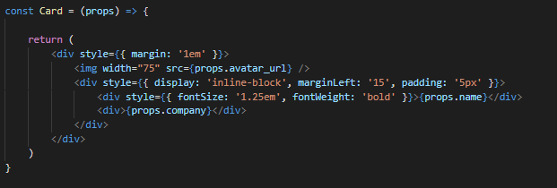
Uncontrolled
Controlled

Slide 7
State/Props
State
Props
State lives locally/internally on a Uncontrolled component.
State has memory, State can be updated or changed.
When state is updated, it will update all sub components that use that state (The components react).
Props are values, passed down from parent components.
Props cannot be changed directly, or updated.
Props are mainly used on controlled components.

Slide 8
How do Components Update?
With the setState() method, this method updates state, and updates all sub components that use that state property.
This process is automatic, but the setState() method, is used in only uncontrolled components.
The setState() can take a parameter, which is the previous state.
The setState() can take a callback function, that can access the new updated state.

Slide 9


